Slide 1

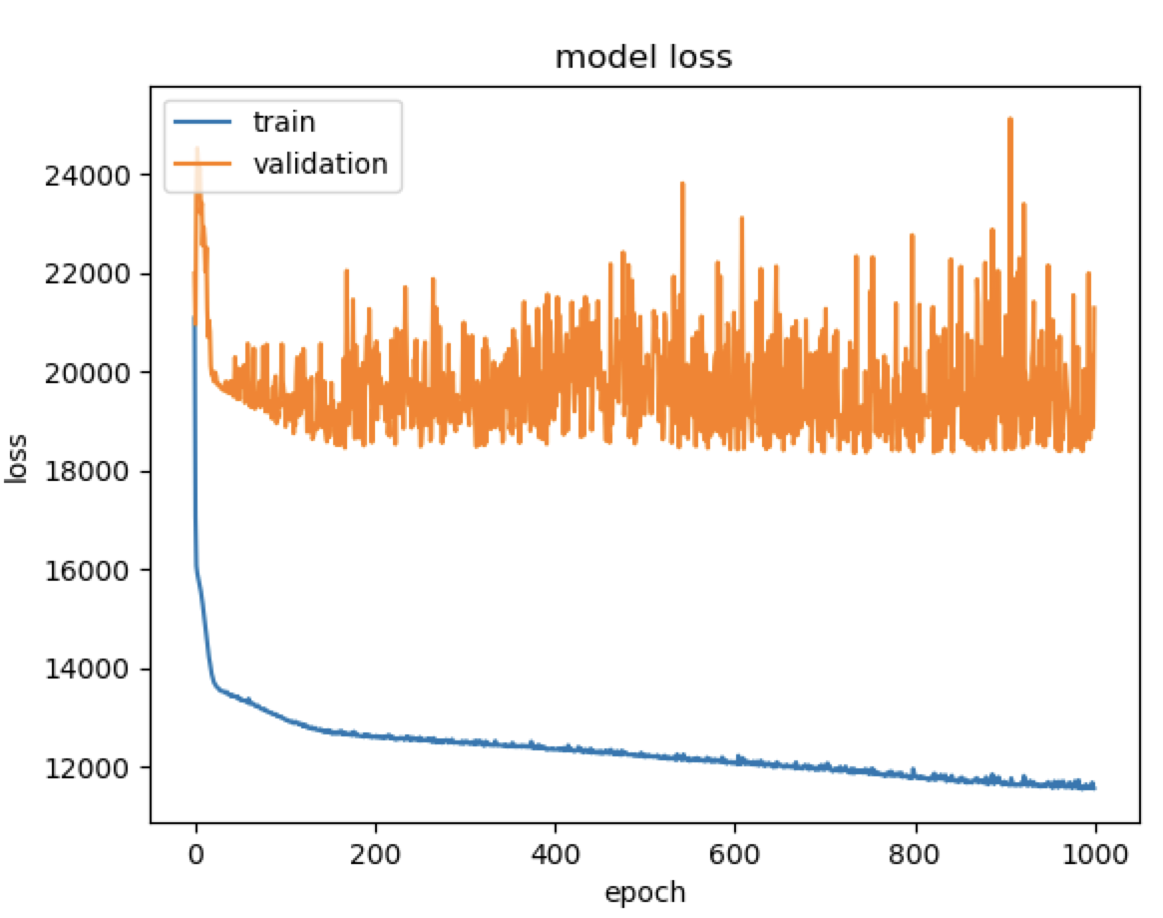
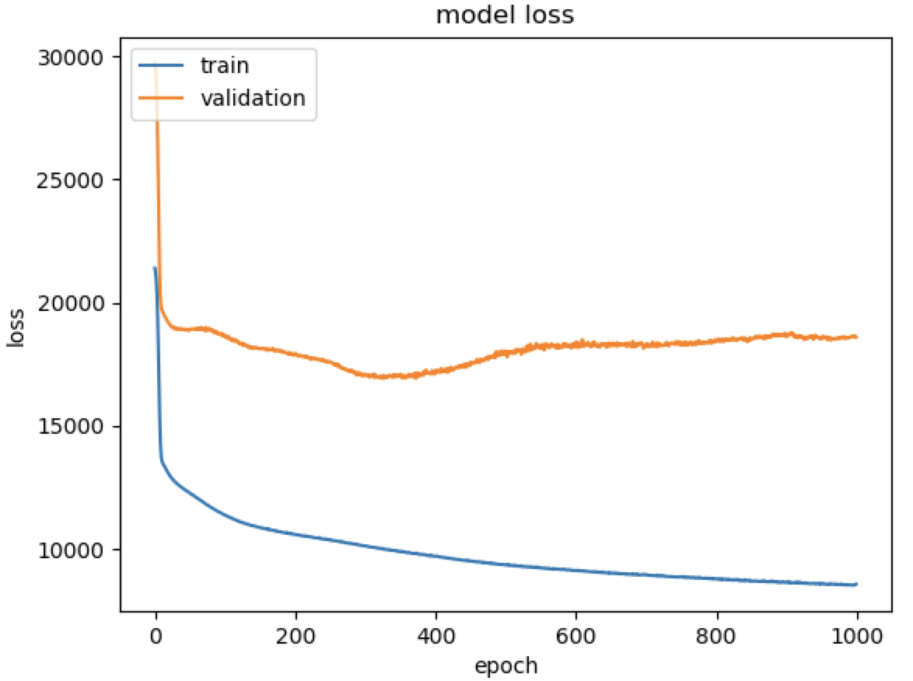
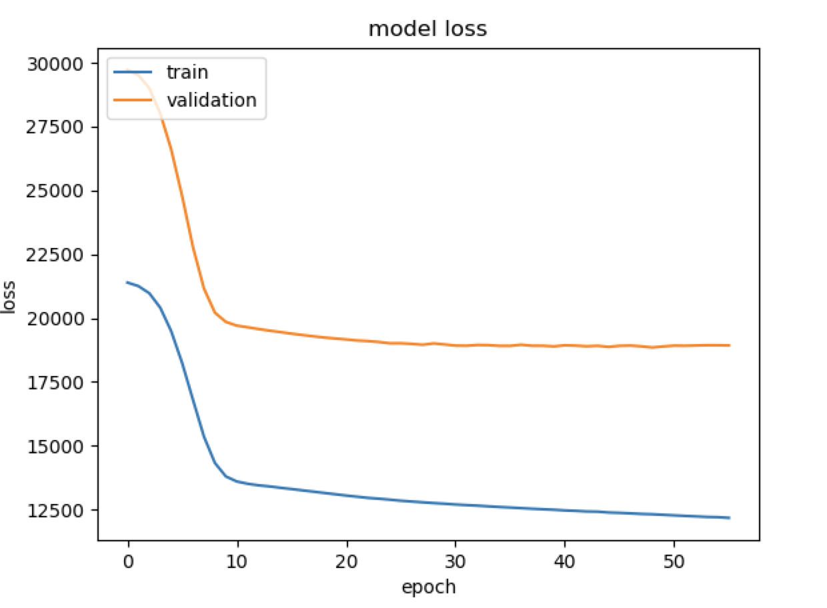
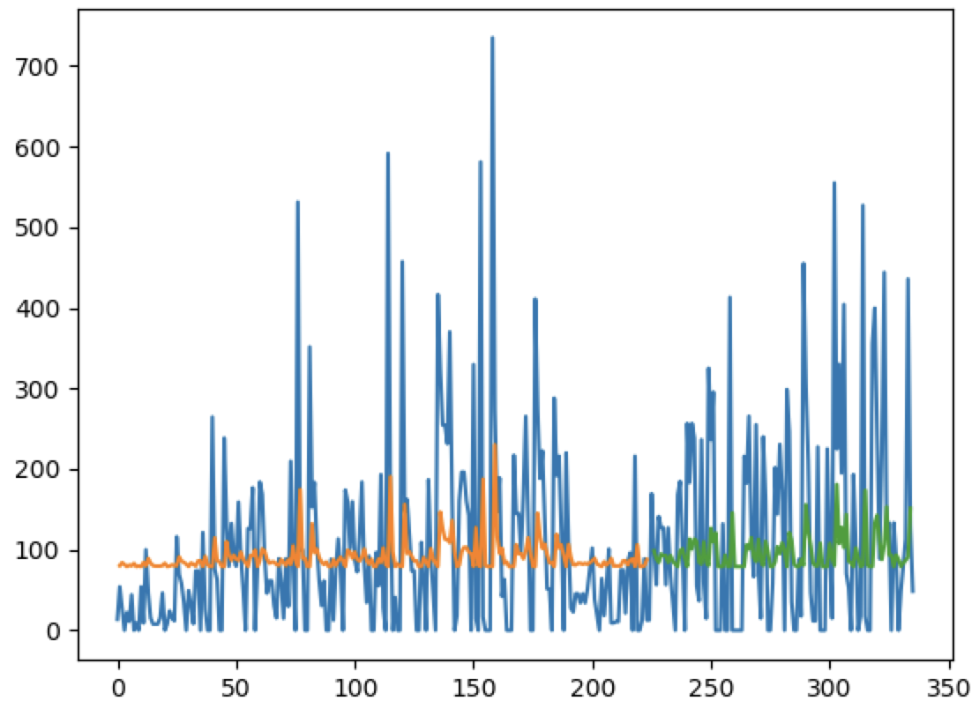
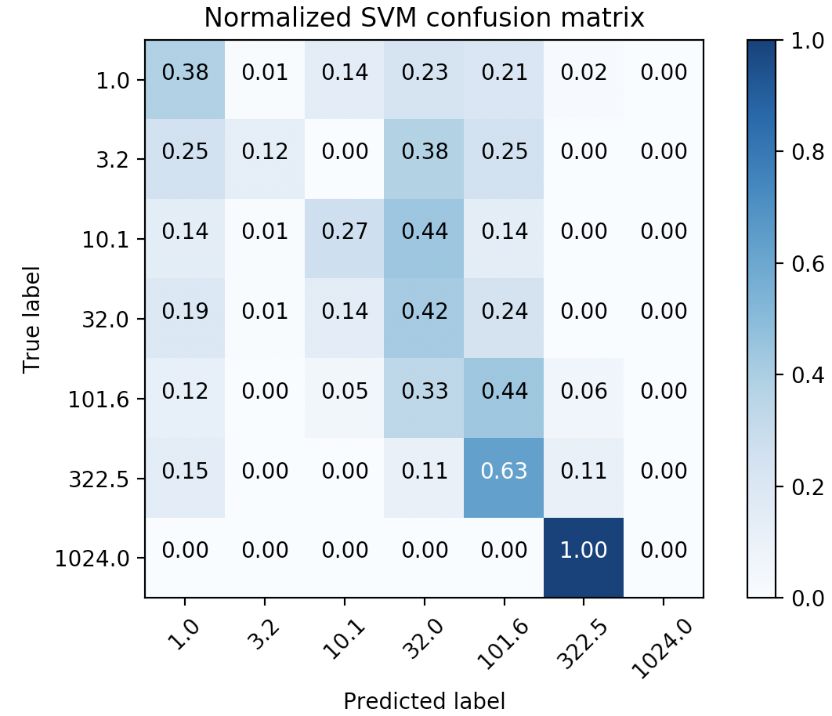

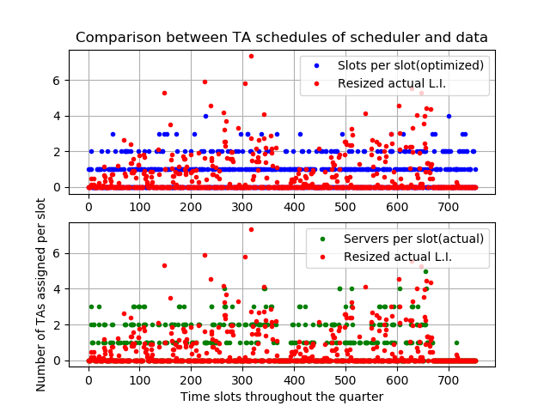
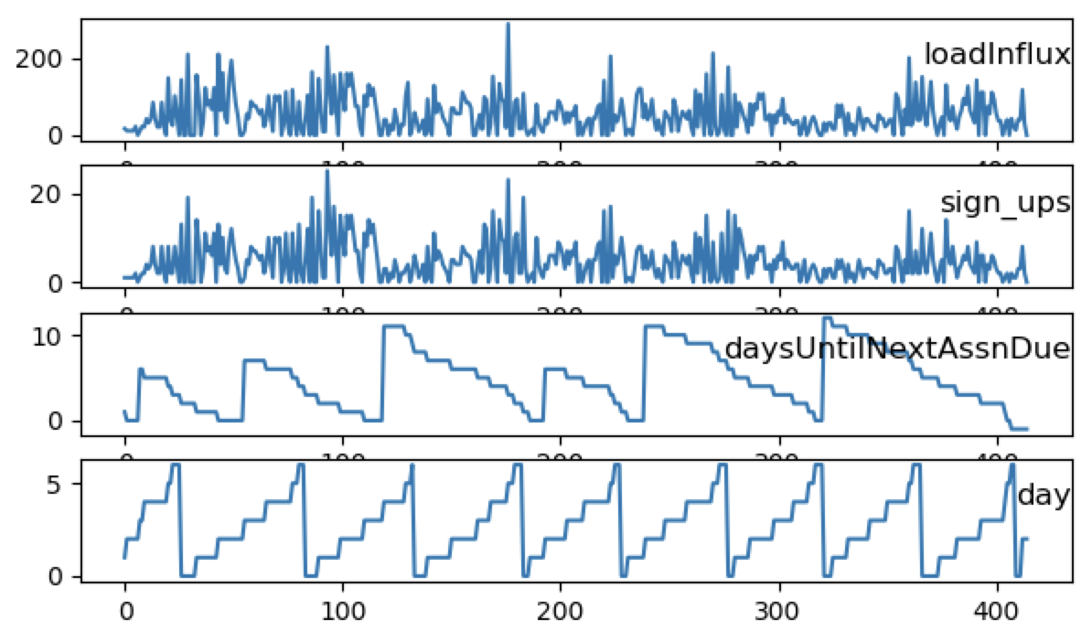
Deep Queue-Learning: A Quest to Optimize Office Hours
CS 229
Avoy Datta, Dian Ang Yap, Zheng Yan
Note: This project is shared between CS221 and CS229. For CS221, we focus on TA scheduling.
CS 229
Introduction
Methodology
Results
OHs often suffer from overcrowding and long wait times, stressing both students and instructors.
If we could accurately predict the expected workload at a given OH, TAs can be better allocated.
QueueStatus, Carta, and course syllabi provide a wealth of information that can be used.
We trained a neural network model that predicts student load influx (expected serve time * # sign-ups) at OH on an hourly basis, for any course.
With these predictions, we now optimize TA scheduling given realistic constraints.
We used normalization and early stopping to prevent overfitting in our NN models.
Collect
Queue Data
Predict
Load Influx
Optimize
TA Scheduling
Without norm With normalization Norm + Early stopping
Training Datasets: CS107 (Spr/Aut 2017, Aut/Win 2018), CS161 (Spr/Aut 2017), CS110 (Spr/Aut 2018), CS229 (Aut 2018)
Test Dataset: CS107 (Spr 2018)
Baselines
Multiclass classification: Used log-scale buckets from 0 – 1024 mins
Initial mode (Univariate LSTM) predicts load influx spikes. (Blue- actual, orange – train predictions, green– validation predictions). Y-axis is the load influx, X-axis represents OH timeslots in chronological order.
Final model (Fully connected NN) predicts load influx spikes. (Blue- actual, orange – test predictions). Y-axis is the load influx, X-axis represents OH timeslots in chronological order. We see that predictions roughly line up with real spikes in student demand. (besides in the last week, when OH was not offered in the actual quarter).
Class Statistics
Table 1: Statistics for sample of classes (4/8 shown)
CS107 Spring 2018 (Test set)
Class | Quarter & Year | #OH-Active TAs | Total # Students | Total OH Hours | Total Served | Total Load Influx
CS107 | Spring 2017 | 13 | 184 | 415 | 1722 | 21873.09
CS161 | Spring 2017 | 6 | 93 | 204 | 875 | 15380.68
CS110 | Spring 2018 | 20 | 187 | 223 | 1749 | 35459.1
CS229 | Autumn 2018 | 17 | 634 | 369 | 1390 | 31733.7
Comparison of suggested TA schedule and actual TA schedule. We see that our recommendations roughly line up with real spikes in student demand
SVM accuracy: 37.3% Random Forest accuracy: 35.9%
Features and Preliminary Statistics
Cosine similarity, actual schedule | Cosine similarity, optimized schedule
0.688 | 0.288
Load influx is significantly and positively correlated with:
Week number (r = 0.07) and Number of servers (r = 0.32)
Significantly and negatively correlated with: Days left until assignment due (r= -0.08), Hour of day (r = -0.10), Weekday (r=-0.09), Days until next exam (r = -0.06)
Summary
Using data scraped off of Stanford course resources, a fully connected NN, and Gibbs sampling, we have come up with a system that schedules TA hours (within realistic constraints) that appears to correlate well with student demand.
Major challenges included computational constraints, overfitting, applying real-life TA constraints, and deciding criterion of “optimality” for assignments.
Over the next week, we will extend this to more general testing data, including courses we have not seen before (ex. CS224N). We will also identify and implement metrics to estimate the efficacy of our model compared to the status quo.
.
References
[1]
[2]
[3]

